Slide 1

Literature survey
Blessing, Rolih, Ernest, Cristian

Slide 2

Hybrid CNN-LSTM and Domain Modeling in Climate-Energy Analysis for a Smart Environment
Correlation between power generation and temperature – local / state level
Predict net energy generation based on the temperature and identify interdependencies for smart cities
Hybrid approach CNN-LSTM, domain knowledge in Environmental Science
Python’s Sckit Learn is used for the implementation

Slide 3
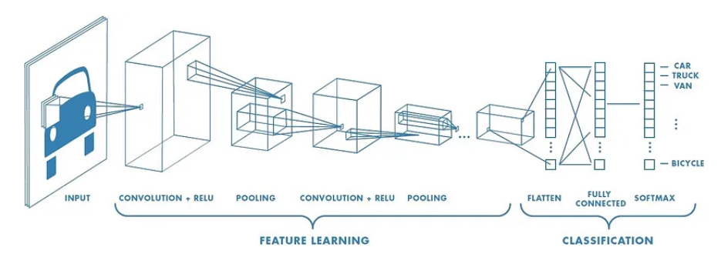
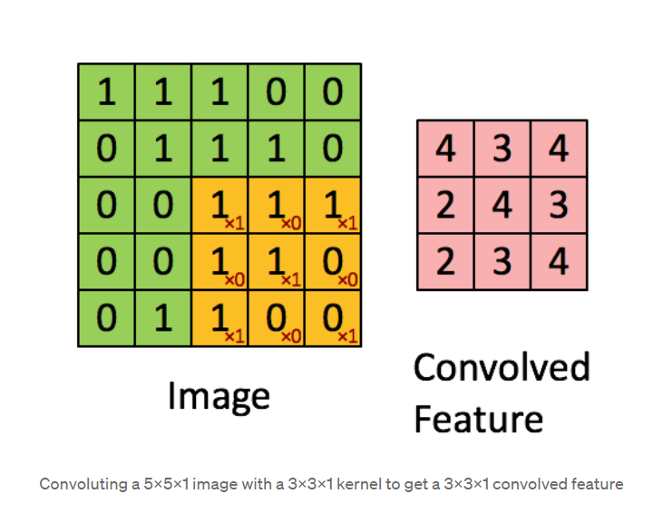
Convolutional Neural Networks (CNN)
Deep Learning algorithm that:
takes in an input image
assign importance (learnable weights and biases) to objects in the image
Identify features and predict them
CNN is used for image processing in object recognition

Slide 4
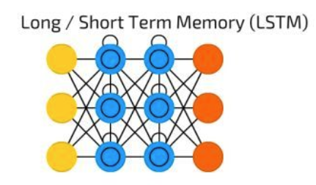



Long-Short Term Memory (LSTM)
Memory cell for storing Long-term information and gates (forget, input, and output)
Forecasting, analysis in time series and sequential data tasks (language processing, speech recognition, etc)

Slide 5
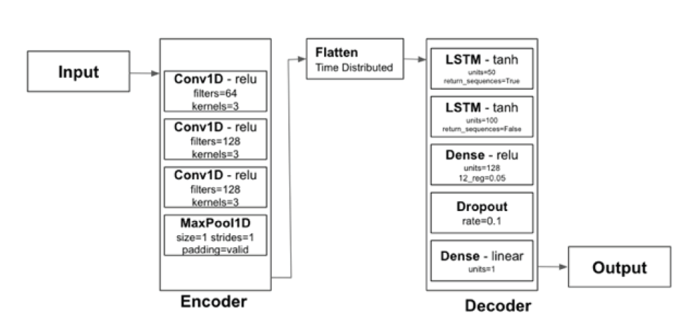
CNN-LSTM TO PREDICT NET ENERGY GENERATION FORECASTING
CNN: categorize weather conditions
3 layers to analyze the data, then amplify its features
LSTM: learn solar power generation
3 layers, uses learned weights to make complex decisions based on the extracted features

Slide 6
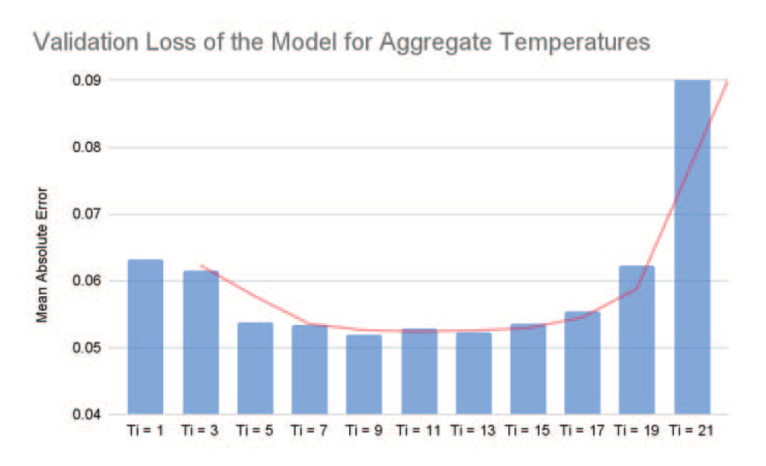
Smart Cities with AI
CNN-LSTM diversification
9 to 13 temperature readings on the power plant have a better performance across the model
Real-time temperature allows dynamic adjustment in energy generation controlling greenhouse gas (GHG) emissions

Slide 7
Reference
S. Shrestha, B. Buckley, A. S. Varde and D. Cwynar, "Hybrid CNN-LSTM and Domain Modeling in Climate-Energy Analysis for a Smart Environment," 2023 IEEE 35th International Conference on Tools with Artificial Intelligence (ICTAI), Atlanta, GA, USA, 2023, pp. 229-233, doi: 10.1109/ICTAI59109.2023.00041. keywords: {Climate change;Convolutional neural networks;Electricity;Long short term memory;Predictive models;Smart devices;Smart cities;Power generation;CNN;Climate Studies;Electricity;Energy;LSTM;Predictive Modeling;Smart Environment;Smart Cities},
https://towardsdatascience.com/a-comprehensive-guide-to-convolutional-neural-networks-the-eli5-way-3bd2b1164a53

